Slide 1
Dependencies

Slide 2
Outline
Versions
Types
Transitive Dependencies
Scopes

Slide 3
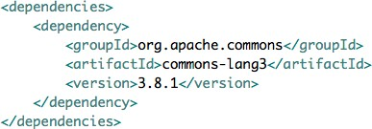
List what you need
Transitive
3 items required: groupId artifactId version

Slide 4
SNAPSHOT
myapp-1.0-SNAPSHOT.jar
Release
Industry common terms myapp-1.0-M1.jar myapp-1.0-RC1.jar myapp-1.0-RELEASE.jar myapp-1.0-Final.jar
Versions

Slide 5


Packaging Types
pom, jar, war, ear, maven-plugin Default jar
Dependency Pom

Slide 6

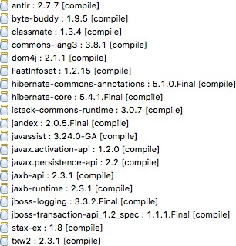
Transitive Dependencies
If you add a dependency:
Transitive Dependencies are downloaded:

Slide 7
Scopes
compile
provided runtime test system import

Slide 8

Demo
Add a dependency
Reference transitive dependencies Use scopes

Slide 9

Version numbers
SNAPSHOT
Summary
Types
Transitive dependencies Scopes

